Slide 1


UMAT-SRID
OBJECT ORIENTED PROGRAMMING PRACTICALS

Slide 2
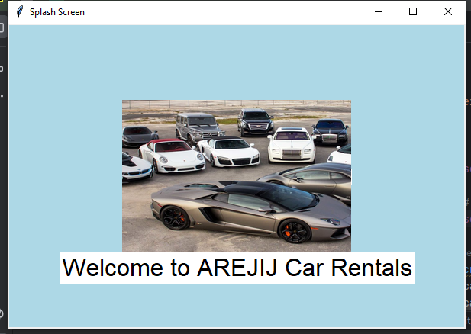
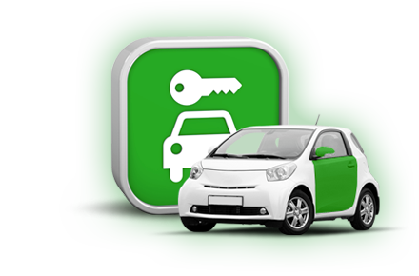
AREJIJ CAR RENTAL MANAGEMENT SYSTEM
YOUR ONE STOP CAR RENTAL MANAGEMENT SYSTEM

Slide 3
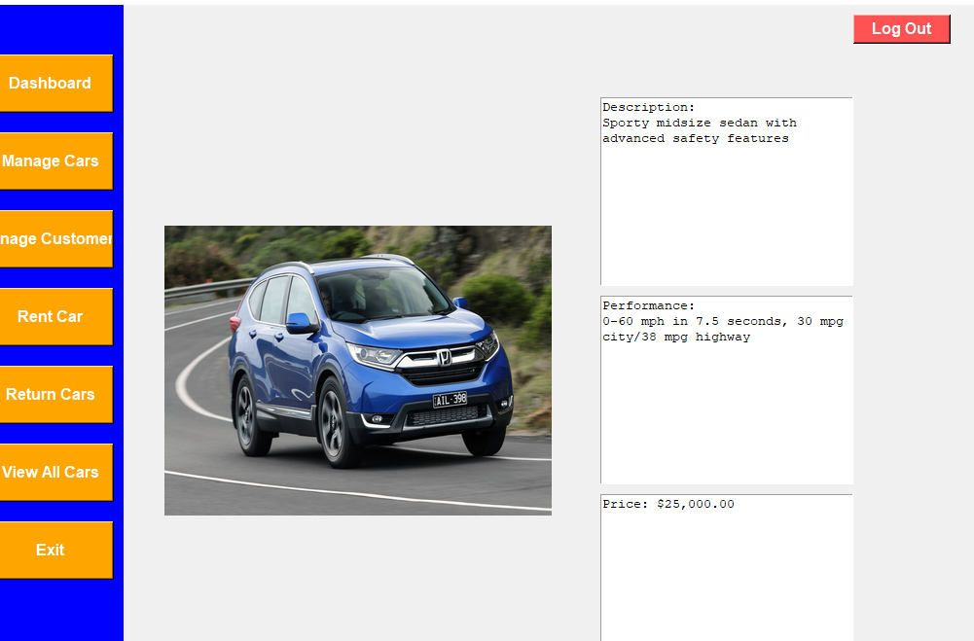

Car Rental System Overview
Car Rental System
Purpose of car rental system
Core Components
Functionalities
User Interfaces
System design and Architecture
Benefits

Slide 4
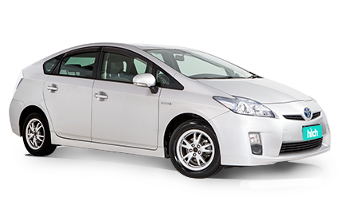
Introduction
AREJIJ Car Rentals streamlines car rentals with a user-friendly interface and efficient management tools.
Effortlessly manage rentals with AREJIJ Car Rentals, a complete system for customers and admins.
AREJIJ Car Rentals simplifies booking, managing, and tracking car rentals in one seamless platform.
Optimize your car rental business with AREJIJ, offering intuitive vehicle
and rental management.
AREJIJ Car Rentals delivers a sleek, efficient solution for all your car rental needs.

Slide 5
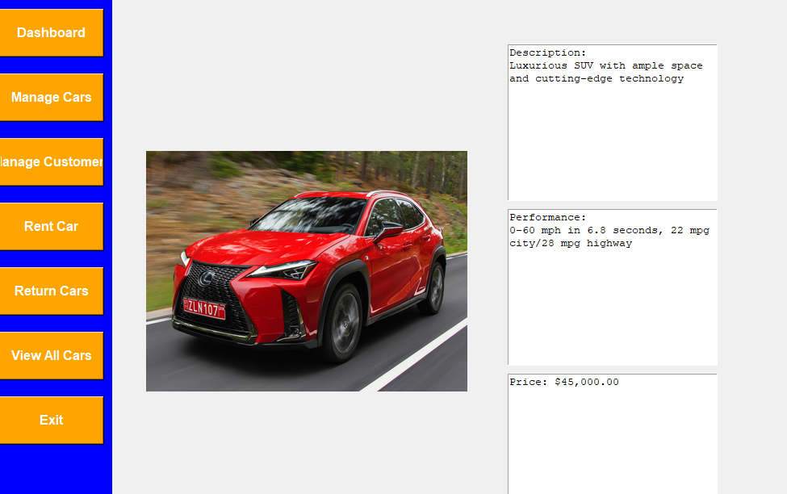

CAR RENTAL MANAGEMENT SYSTEM
Our Car Rental System is a software application designed to manage the various aspects of a car rental business.
The system automates the rental process, ensuring efficiency, accuracy, and convenience for both customers and business operators.
AREJIJ CAR RENTAL SYSTEM LET'S DIVE IN....

Slide 6
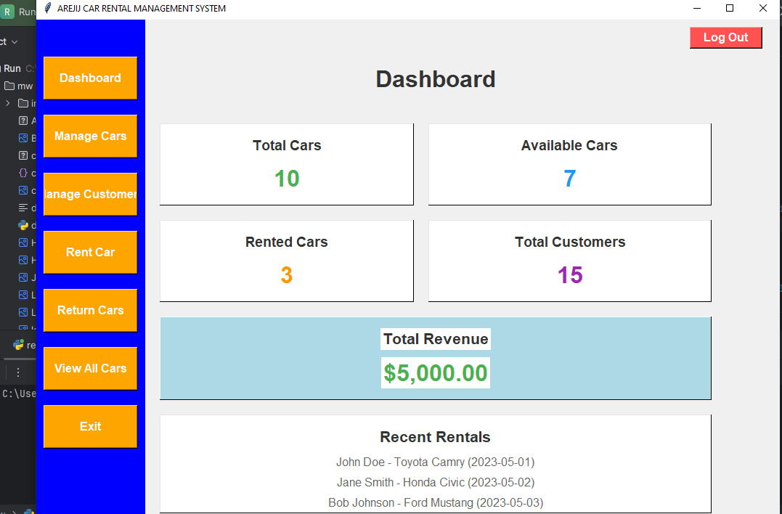

Purpose of car rental system
Streamline Rental Operations: Automates the entire rental process, from booking to vehicle return, to minimize manual work and errors.
Enhance Customer Experience: Provides a user-friendly platform for customers to book and manage rentals easily.
Improve Fleet Management: Tracks vehicle availability, maintenance schedules, and rental history to optimize fleet utilization.
Increase Revenue: By improving efficiency and customer satisfaction, the system helps increase bookings and revenue.
Reduce Costs: Minimizes paperwork, errors, and manual labor, leading to cost savings.

Slide 7
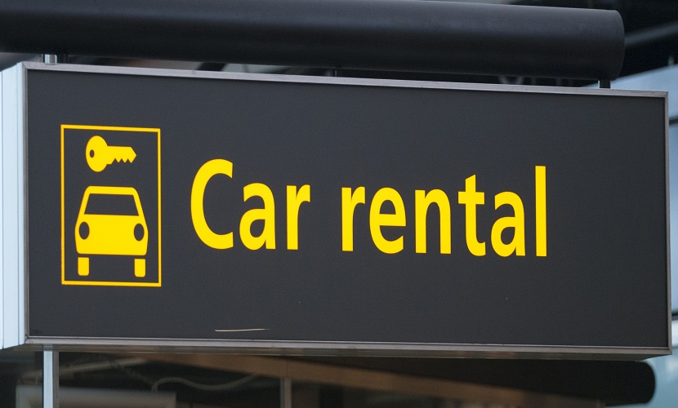
Core Components of Car Rental System
Vehicle Management: Handles inventory management, including adding new vehicles, updating vehicle information, and tracking the status (available, rented, under maintenance).
Customer Management: Manages customer profiles, including personal details, driving license information, and rental history.
Booking and Reservation: Allows customers to browse available vehicles, check rates, and make reservations online or in-person.
Rental Agreement Management: Automates the creation of rental contracts, capturing details like rental duration, vehicle condition, and terms and conditions.
Payment Processing: Integrates with payment gateways to handle transactions securely, including deposits, rental fees, and fines.
Reporting and Analytics: Generates reports on various aspects like rental trends, revenue, vehicle utilization, and customer demographics to aid decision-making.
Vehicle Maintenance: Tracks vehicle service schedules, records maintenance history, and alerts the management about upcoming maintenance needs.

Slide 8
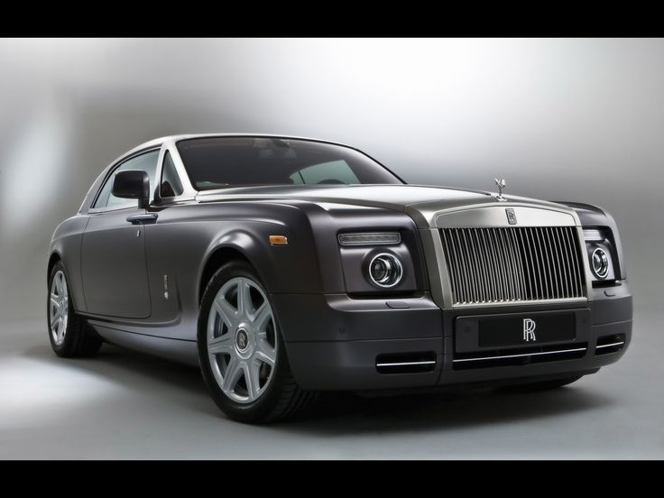
Functionalities Of Car Rental System
Search and Filter: Customers can search for vehicles based on criteria like type, availability, price, and location.
Real-time Updates: The system provides real-time updates on vehicle availability and booking status.
Customizable Pricing: Supports dynamic pricing models based on factors like demand, rental duration, and customer loyalty.
GPS Integration: Offers real-time tracking of vehicles, which is crucial for both management and customers.
Notifications: Sends automated alerts and reminders for upcoming bookings, due returns, overdue rentals, and maintenance schedules.
Integration with External Systems: Connects with accounting software, CRM systems, and third-party platforms for seamless operations.

Slide 9
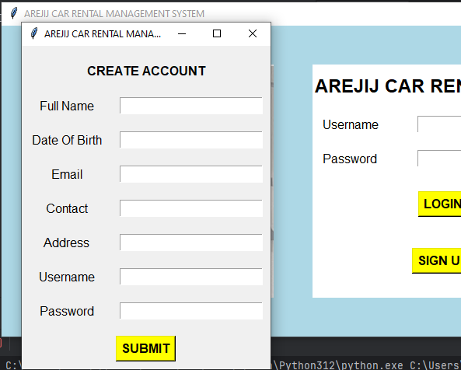
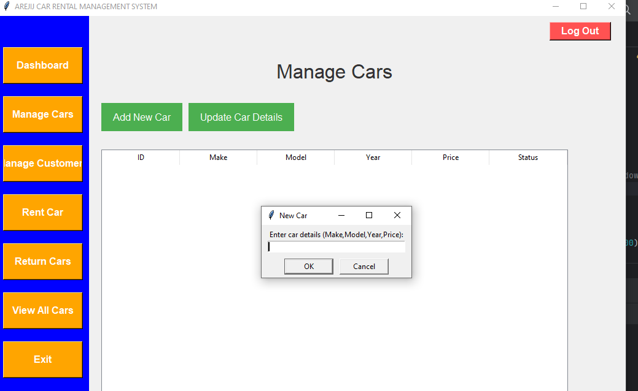
User Interfaces
Customer Interface: Typically a web or mobile app where customers can browse vehicles, make bookings, and manage their rentals.
Staff Interface: A backend portal for employees to manage daily operations like vehicle check-ins, processing bookings, and handling customer inquiries.
Admin Interface: A dashboard for administrators to manage the entire fleet, monitor performance, and configure system settings.

Slide 10
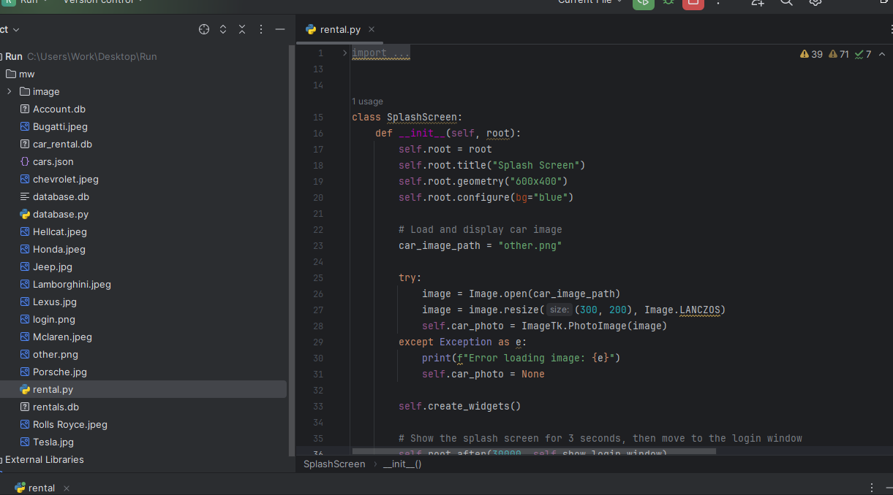

System Design and Architecture
Frontend: Built using python programming language with tkinter library.
Backend: Typically powered by server-side python language.
Database: Uses database MySQL to store and manage data related to vehicles, customers, and transactions.
Security: Incorporates data encryption, role-based access control, and secure payment processing to protect sensitive information.
Scalability: Designed to handle a growing number of users, vehicles, and transactions, often using cloud-based infrastructure.

Slide 11
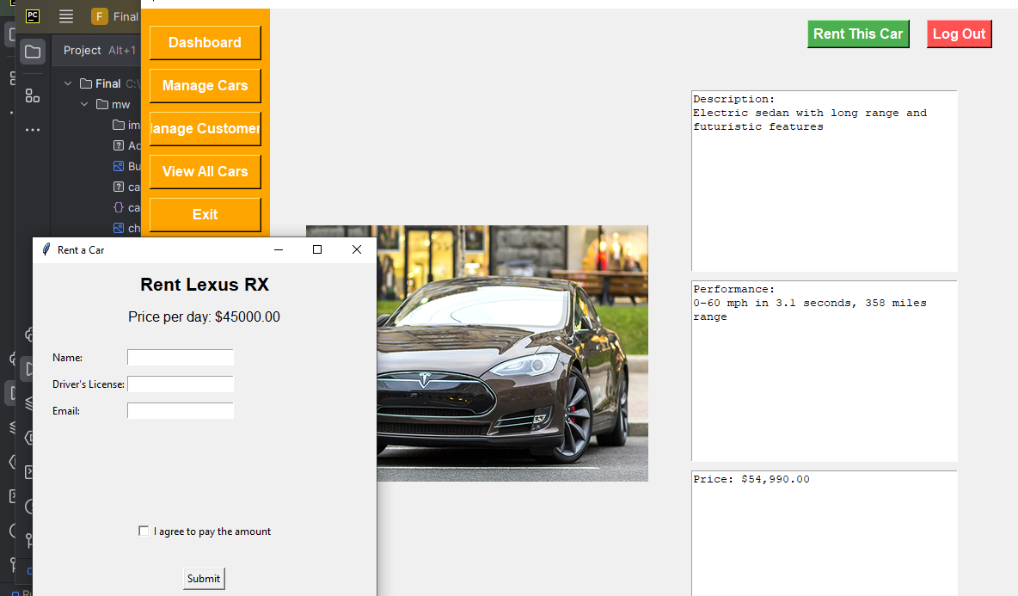
Benefits for Hiring a Car on Rent:
Efficiency: Automates routine tasks, reducing the need for manual intervention.
Accuracy: Minimizes errors in bookings, billing, and vehicle management
Customer Satisfaction: Provides a convenient and reliable service to customers.
Cost-Effective: Reduces operational costs through automation and streamlined processes.
Data-Driven Decisions: Offers insights and analytics to make informed business decisions.

Slide 12
Thank You
PRESENTATION BY AREJIJ GROUP@AREJIJ CAR RENTAL MANAGEMENT SYSTEM

